Slide 1

Dynamic Pricing for EV Charging Station
Submitted By:
Saradindu Rana [ T91-CSE-186011 ]
Debopriyo Ghosh [ T91-CSE-186003 ]
Saikat Jana [ T91-CSE-186017 ]

Slide 2
Introduction
63 lakh units mark
per annum by 2027: IESA
1
2
Power Demand 100 TWh by 2030
market is expected to expand at a CAGR of 44% 2020-27
3
4
The Govt. Initiative EV30@30
So, at this stage, EV charging stations are an essential factor for the success of EVs, along with their performance improvement, they are required to satisfy both the stability of power grids and to offer a reasonable Quality of Service to customers.

Slide 3


Problems in current scenario
Longer charging time can create waiting queues in charging stations in peak hours
Accessing public chargers status is really complicated
Current increasing trend of EV use has a serious impact on the stability of power grids
Traditional Fixed Price Model can create Market Monopoly

Slide 4
Problem Description
Let’s take n number of charging station.
Each station corresponds to a single queue structure is shown in figure.
Si(t) is the size of queue i at time t, where i ∈ N.
For customers, the charging takes an exponential amount of time with service rate μi.
The occurrence of EV charging events follows a Poisson process with rate λ.
by Poisson thinning property, the arrival process at each station is also Poisson with rate λi
01
Station 1 [S1T]
02
Station 2 [S2T]
03
Station 3 [S3T]
.
.
.
n
Station n [SnT]

Slide 5
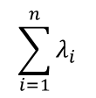
Problem Description
Under those conditions, each queue in the system is a M/M/1 queue
For convenience, we define vectors λ⃗ and μ ⃗ whose elements denote the rate of EV arrival (λ⃗) and station service (μ⃗), respectively. Customers enter one of the stations after the charging station selection and this
lets us consider a constraint such that
is equal to λ.

Slide 6
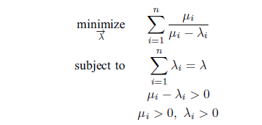

Vehicle Allocation Analysis
From the stationary distribution of M/M/1 queue, the mean queue size (E[N]) at each station is computed by E[Ni]= ui/(ui−λi) This is directly related to the waiting time of customers in a queue. By Little’s law, E[Ni] is proportional to the waiting time. For this reason, we consider the following optimization problem which minimizes the global queue size.
Our first objective is to study a load balancing policy to optimize vehicle allocation. This includes both minimizing the waiting time of customers and preventing the overflow of a station’s waiting size.
This finds the vector λ which minimizes the global number of waiting customers.
Daehyun Ban et.al. [1] have solved this minimization problem in their work, as shown by them
The solution vector λ of this problem is given by:

Slide 7
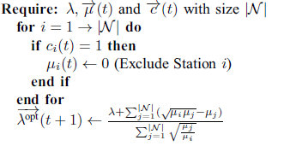
Station Size Limitation and Vehicle Allocation Algorithm
The optimal allocation requires a stability condition on local queues.
During peak times, the incoming PHEV rate can be temporarily higher than service rate (i.e., λopti > μi) and this leads to an increase of the local queue size.
We set a congestion indicator ci(t) as shown below:
ci(t) = 1{Si(t)>Li}, where i ∈ N, Li indicates the size capacity of station i.
Algorithm 1 PHEV Allocation Control

Slide 8
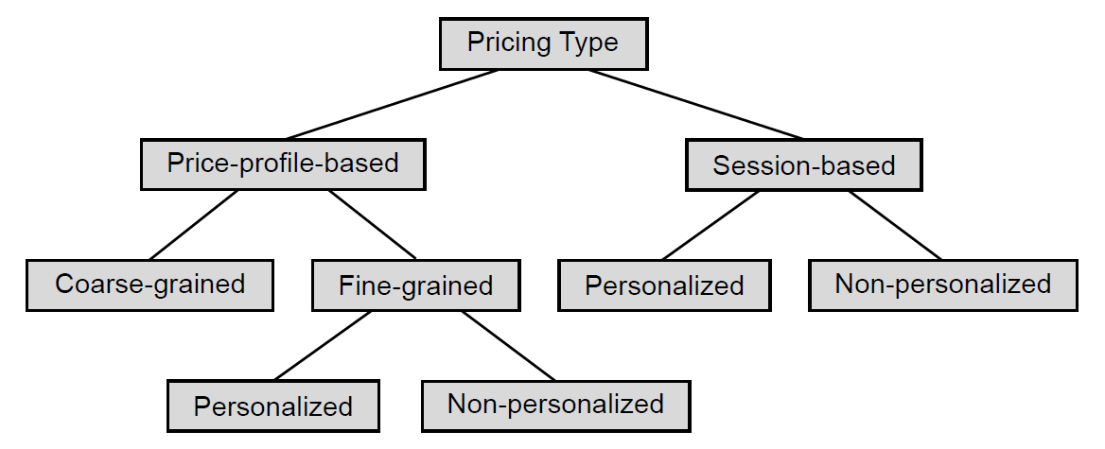
Customer Control by Using Dynamic Pricing:
Steffen Limmer [4] has shown that the pricing strategies can be categorized according to the following figure.
Price-profile-based pricing sets different prices (usually per energy unit) for different time intervals. Mostly used Price profile-based are fine-grained price profiles, which set an individual price for each small scheduling interval which may be for 5 minutes or one hour. However, some authors like Guo et al. [5] propose coarse grained price profiles, which set a constant charging price for a longer time.
For our work we will try to set the price for hourly time slots, so our strategy is a fine grained pricing strategy.

Slide 9
Pricing Strategy
We considered the price update framework as a discrete time system. Each timeslot duration is T and stations have the arrival rate λi and service rate μi in that time slot
for all i ∈ N.
Now we proceed with the price control of stations by using the arrival rate difference between the optimal λiopt (t) and λi(t). At time t, we set this difference to di(t): di(t) = λi(t) − λiopt(t), where i ∈ N
A positive di(t) means that more vehicles than optimal are entering into station i, meaning that it is required to decrease the input rate.
In addition, the price for the station i at time slot t will be:
pi(t) = Base price + γdi(t), where i ∈ N
Now we have to know about the arrival rate of the vehicles at time slot t.

Slide 10
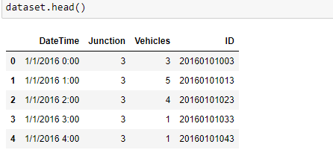
Predicting the arrival rate
Let’s say we want to set the price for the time slot 10 a.m. to 11 a.m. for doing so we need to know how many vehicles may come in that time slot. As we don’t know what will be the arrival rate for that slot, we need to predict it. The dataset we used for predicting the arrival rate is taken from ‘Geeksforgeeks’.[8]. The dataset has two columns which are useful to us one is hourly time slot and another is number of vehicles that have arrived in that time slot.

Slide 11
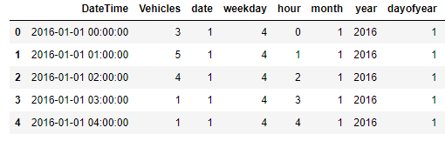
As a step of preparing the dataset, we extracted the following features from the dataset.
Now, we have used random forest regression technique on the datasets for predicting the arrival rate, and prepared 10 model for 10 charging stations.

Slide 12




Accuracy of the models:

Slide 13
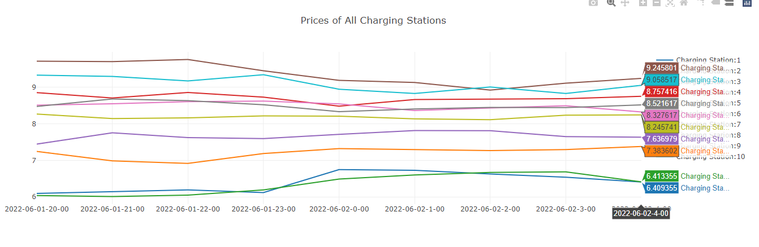
Prices at different stations after implementation
The higher price simply indicates that, the charging station is getting more number of arrivals of the EVs than the other stations.

Slide 14
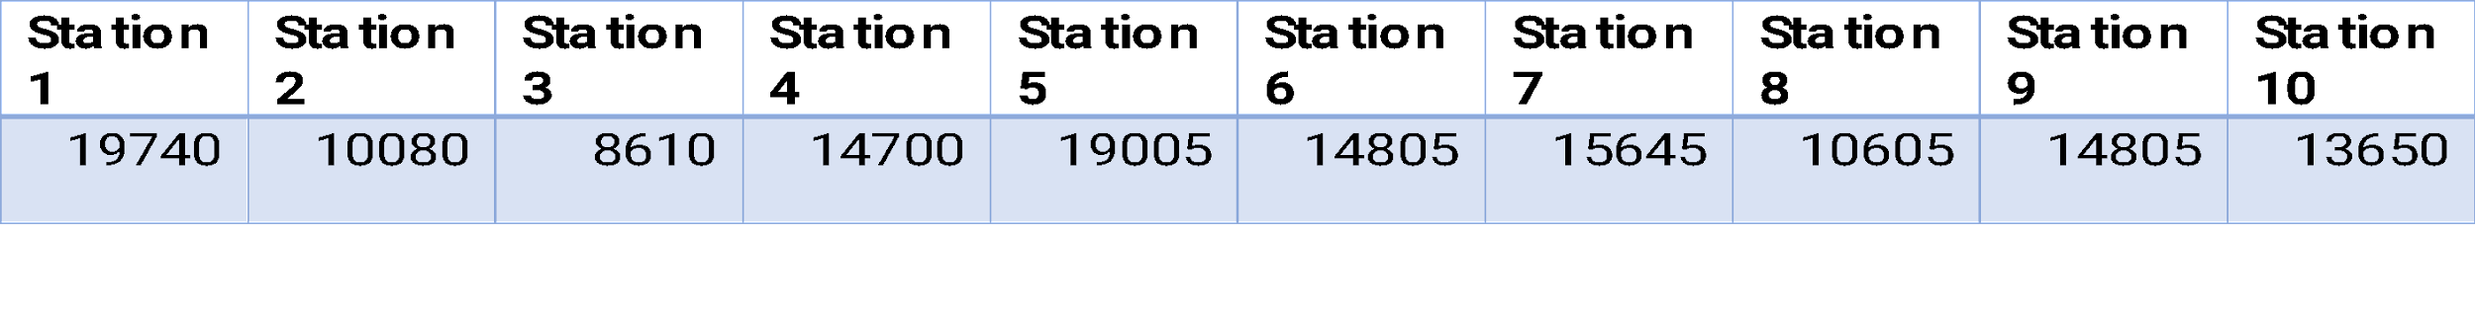
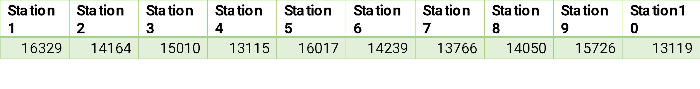
Reducing Monopoly
According to a report by INC42 [10] on an average the EV’s take up to 30 unit of electricity. So, for the traditional fixed pricing strategy (8 rupees per unit), the income of the 10 charging stations for one day according to the dataset would look like following:
We can clearly see that station 1 and 5 is having duopoly, where station 3 is having very less income.
If we can achieve the optimal rate and instead of using the fixed pricing if we take the dynamic prices the income on the same day looks like following:

Slide 15

Web platform implementation
We made a web platform where user can see the real time charging prices of different stations, so they can decide where they want to charge their EVs.

Slide 16
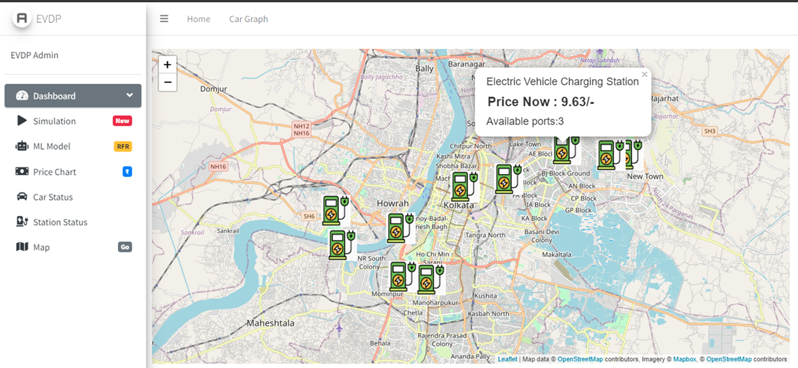
Admin page:
After successfully logging in to the admin page admin can see the current status of any charging station, i.e., how many vehicles are charging and how many are waiting in that moment. Admin can also check current charging price in all the charging stations in that moment.
Technology Used in Implementation: HTML5, CSS, JavaScript, Bootstrap, Admin LTE 3.0.
A view of Dashboard.

Slide 17
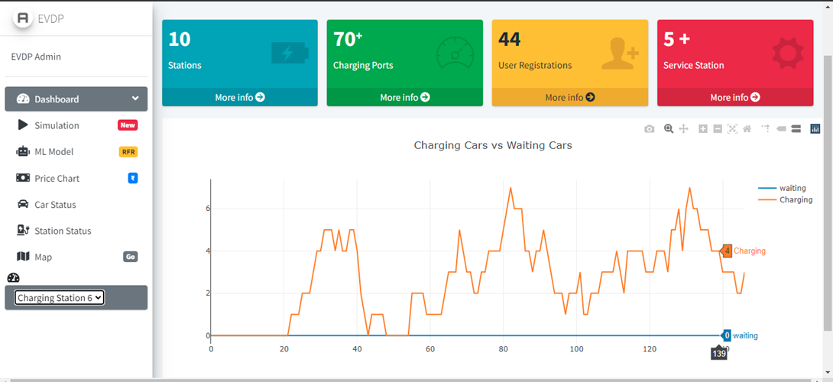
Admin can see the current status of any charging station, i.e., how many vehicles are charging and how many are waiting in that moment

Slide 18
User page:

Slide 19

Conclusion:
In this work we tried to propose an EV charging station framework which will satisfy both the QoS of customers and charging station stability. The main assumption of our work is that user will not choose the stations which has more price per unit for charging in that time slot. If the assumption follows the stations with congestion will not face new arrivals and the load will be distributed. But dynamic pricing arises questions like how do EV drivers respond to dynamic prices in reality? Furthermore, it is not clear if a dynamic pricing scheme would be accepted by the users at all.
Future Works:
OCPP (Open Charge Point Protocol) 2.0.1 Implementation.
Android application design for user.
Traffic Modeling Simulation of a city.
Add Realtime Charging station using Open Charge Alliance and their dataset.
Personal Domain and Hosting in Cloud.

Slide 20
References:
Daehyun Ban∗, George Michailidis, and Michael Devetsikiotis, Demand Response Control for PHEV Charging Stations by Dynamic Price Adjustments.
Electric vehicle market in India expected to hit 63 lakh units per annum mark by 2027: IESA .PTI. December 22, 2020.
How Electric Vehicles Will Impact Electricity Demand, India’s Grid Capacity. 02 Apr'20 .Amit Raja Naik.
Dynamic Pricing for Electric Vehicle Charging—A Literature Review Steffen Limmer. DOI:10.3390/en12183574.
Guo, Y.; Liu, X.; Yan, Y.; Zhang, N.; Su, W. Economic Analysis of Plug-in Electric Vehicle Parking Deck with Dynamic Pricing. In Proceedings of the 2014 IEEE.
Luo, C.; Huang, Y.F.; Gupta, V. Dynamic Pricing and Energy Management Strategy for EV Charging Stations under Uncertainties. In Proceedings of the International Conference on Vehicle Technology and Intelligent Transport Systems, VEHITS 2016, Rome, Italy, 23–24 April 2016; Volume 1, pp. 49–59, [CrossRef].
Luo, C.; Huang, Y.F.; Gupta, V. Stochastic Dynamic Pricing for EV Charging Stations with Renewable Integration and Energy Storage. IEEE Trans. Smart Grid 2018, 9, 1494–1505, [CrossRef]
Vehicle Count Prediction from Sensor Data. 12 Oct, 2021. Sravankumar.
Yanli Liu, Yourong Wang & Jian Zhang. New Machine Learning Algorithm: Random Forest.
Ground Reality: The Math Behind India’s Electric Vehicle Charging Infrastructure. 25 Feb'20 | By Amit Raja Naik.

Slide 21

THANK YOU

